Slide 1
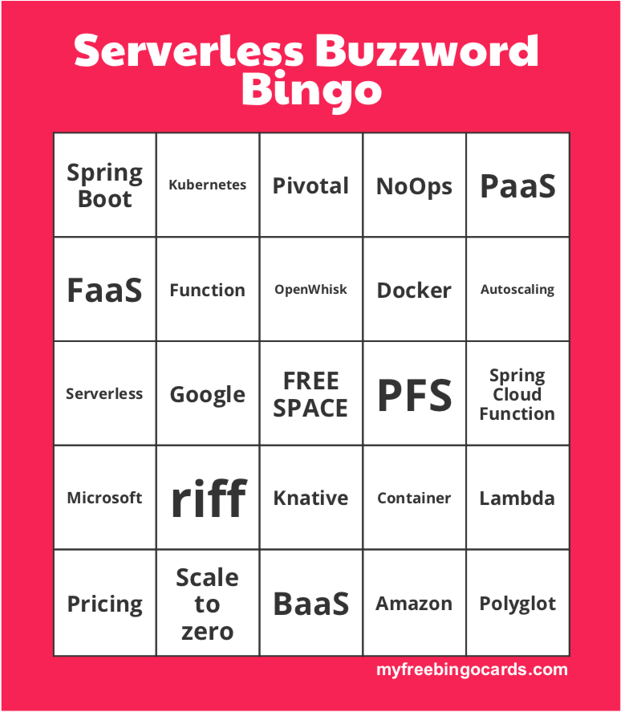
SPRING, FUNCTIONS,
SERVERLESS,
AND YOU

Slide 2


MICHAEL MINELLA
Lead – Spring Batch &
Spring Cloud Task
JSR-352 - Expert Group Member
Author – Pro Spring Batch
Speaker - JavaOne Rockstar
Podcast - OffHeap Curmudgeon
Twitter - @michaelminella or
@OffHeap

Slide 3


Slide 4

SLIDES AND CODE
WILL BE ON GITHUB SOON
https://github.com/mminella/riff-demo

Slide 5

Notes:
Please ask questions when you have them

Slide 6

AH, THE CLOUD
Notes:
Cloud by Dinosoft Labs from the Noun Project

Slide 7

MOVING ALL
OUR CODE TO IT
Notes:
release management by Shocho from the Noun Project

Slide 8
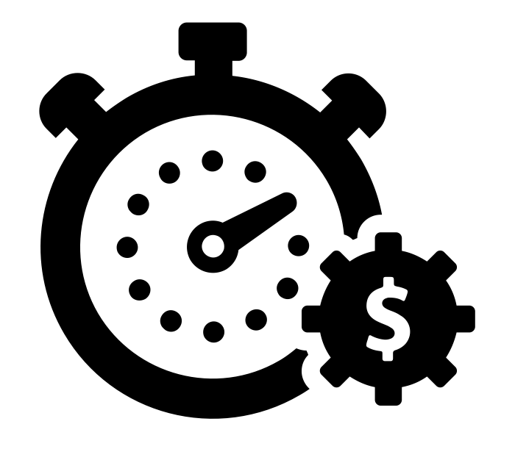
MADE US MORE
PRODUCTIVE
Notes:
Productivity by Gregor Cresnar from the Noun Project

Slide 9

LESS HEADACHES
Notes:
Headache by priyanka from the Noun Project

Slide 10


RAINBOWS AND UNICORNS

Slide 11

SERVERLESS AND FUNCTIONS

Slide 12

DO FUNCTIONS RUNNING
ON SERVERLESS PLATFORMS!
Notes:
Proselytize by Dan Hetteix from the Noun Project

Slide 13

HAPPY DEVELOPERS

Slide 14

ANGRY BUSINESS

Slide 15

GOALS FOR TODAY
Notes:
goal by Adrien Coquet from the Noun Project

Slide 16

FaaS
FUNCTIONS
SERVERLESS
Notes:
path by Adnen Kadri from the Noun Project

Slide 17

TECHNICAL AND
ARCHITECTURAL
CONSIDERATIONS

Slide 18



Slide 19

JUST ANOTHER TOOL
IN YOUR TOOLBOX
Notes:
Toolbox by Joost Haar from the Noun Project

Slide 20


SERVERLESS
Notes:
Server by Chad Remsing from the Noun Project
X by rayhan maulana rikzan from the Noun Project

Slide 21

Notes:
confused by RULI from the Noun Project

Slide 22

5 TRAITS
Notes:
Mike Roberts
https://blog.symphonia.io/defining-serverless-part-1-704d72bc8a32
DNS by Alexander Skowalsky from the Noun Project

Slide 23
1
NO MANAGEMENT OF
SERVER HOSTS OR PROCESSES
Notes:
Not concerned with VMs or physical machines
Not concerned with the idea of a long running “server”

Slide 24
2
SELF
AUTOSCALES AND PROVISIONS
Notes:
All scaling and provisioning occurs based on load as determined by the platform.

Slide 25
3
PAY BY USE
Notes:
Only pay for the exact time of execution
Pinging servers to keep them alive is now “a thing”

Slide 26
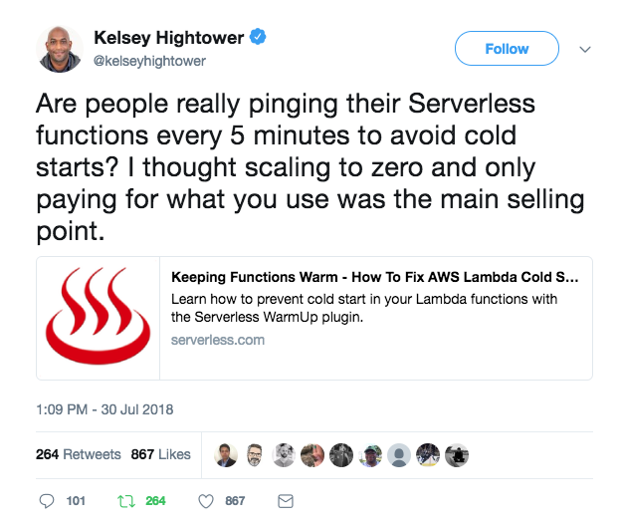
Notes:
https://twitter.com/kelseyhightower/status/1023994078873047040

Slide 27
4
PERFORMANCE CHARACTERISTICS
NOT VIA HOST SIZE OR COUNT
Notes:
You don’t get to pick instance size, etc.
RAM typically for an application
Backend-as-a-Service (BaaS) typically use things like throughput
Some platforms don’t let you dial ANY knobs
This is an example of Serverless immaturity (providers still figuring out what knobs to expose)

Slide 28
5
IMPLICIT
HIGH AVAILABILITY
Notes:
HA here is defined as the ability for the system to continue to operate even if one instance of a component fails
Serverless components are pieces of code that are ephemeral and event triggered.
Because of this, we cannot create a system that is HA without the underlying Serverless services being HA
Example:
We assume that if one of our FaaS nodes crashes, the underlying Serverless platform will launch a new one.
S3 – We upload/download files to the service. However, we don’t concern ourselves with what server or node. We assume that if an S3 component fails, our data is safe and still accessable. This is implicit HA.
Failovers can be felt by clients however.
HA != Disaster recovery
We are not talking about a vendor providing automatic failover to another service system.
Function running on FaaS 1 is returning consistent 500s because it depends on another service that is down. We are not talking about requests being automatically routed to another Function automatically

Slide 29
Serverless
Platforms
Containers
IaaS
Lower Complexity
Operational Efficiency
Hardware
More flexibility
Less Standardization

Slide 30

WHAT IS A FUNCTION?

Slide 31

A UNIT OF CODE DESIGNED
TO START FAST…
Notes:
Drag Racer by Iconic from the Noun Project

Slide 32

…AND CAN BE
STOPPED
Notes:
stop sign by Universal Icons from the Noun Project

Slide 33

STATELESS FROM
EXECUTION TO EXECUTION
Notes:
new by Dinosoft Labs from the Noun Project

Slide 34
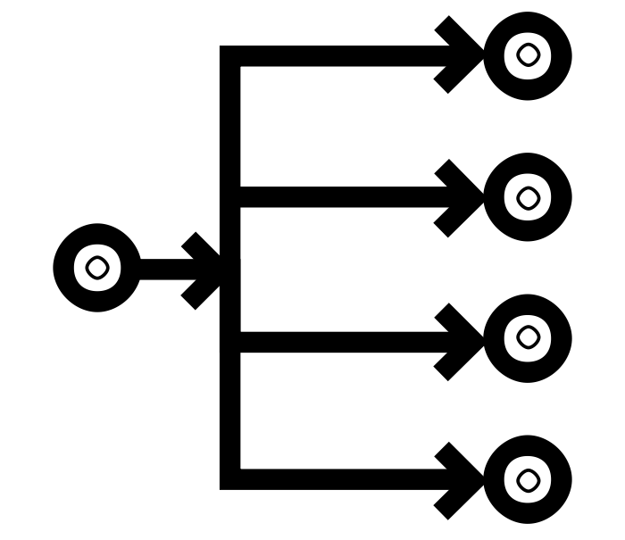
INDEPENDENT OF HOW
IT IS CONSUMED
Notes:
Multicast by SBTS from the Noun Project

Slide 35

I DIDN’T MENTION SIZE
Notes:
Russian Doll by Dima Lagunov from the Noun Project

Slide 36

OR HOW LONG IT TAKES TO RUN
Notes:
stop watch by Samy Menai from the Noun Project

Slide 37









FUNCTION AS A SERVICE

Slide 38
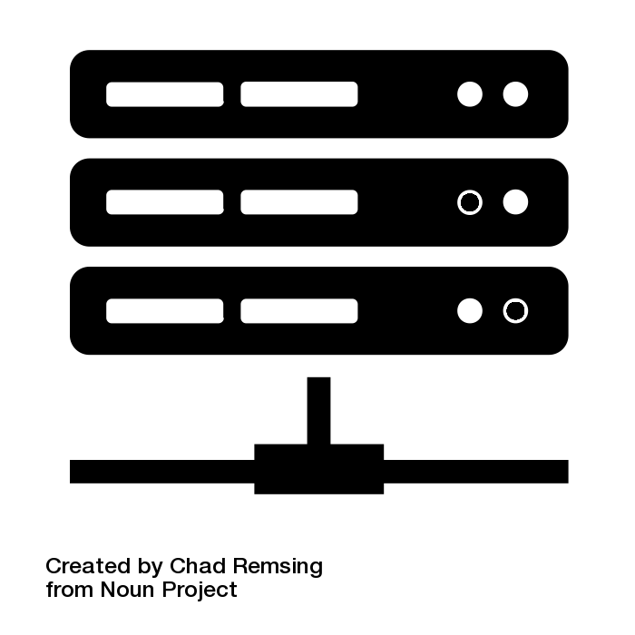

A SERVERLESS
PLATFORM

Slide 39
FOR RUNNING FUNCTIONS
Notes:
What do functions need?
All the things we mentioned about serverless
External stimulus ( when I do run your function? )

Slide 40
SO WHY DO WE CARE?

Slide 41
PLATFORMS PROVIDE
EFFECIENCY GAINS

Slide 42
RESOURCE EFFECIENCIES

Slide 43
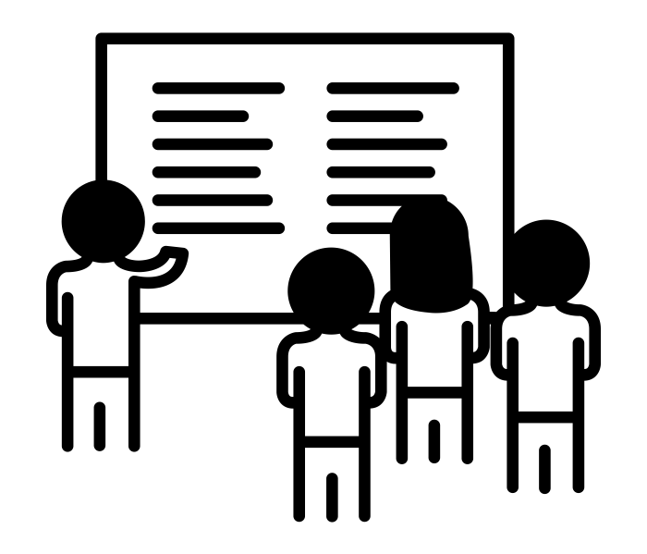
OPERATIONAL
EFFECIENCIES
Notes:
Meeting by Ainsley Wagoner from the Noun Project
No servers to request
Process to get to producing is easier with the smaller the amount of code to get through the red tape

Slide 44
package io.spring.riffdemo;
import java.util.function.Function;
import org.springframework.boot.SpringApplication;
import org.springframework.boot.autoconfigure.SpringBootApplication;
import org.springframework.context.annotation.Bean;
@SpringBootApplication
public class RiffDemoApplication {
public static void main(String[] args) {
SpringApplication.run(RiffDemoApplication.class, args);
}
@Bean
public Function<String, String> reverse() {
return s -> new StringBuilder(s).reverse().toString();
}
}
DEVELOPMENT EFFECIENCIES

Slide 45



WHAT ARE WE GOING
TO USE THIS FOR?
Notes:
Toy by Vladimir Belochkin from the Noun Project
toys by Maria Kislitsina from the Noun Project
Toy by Danil Polshin from the Noun Project

Slide 46
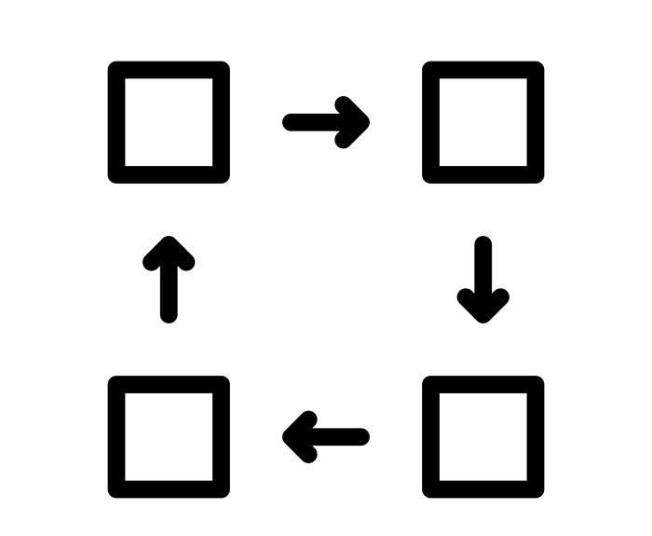
RAPPIDLY EVOLVING
BUSINESS REQUIREMENTS
Notes:
iterative by Ralf Schmitzer from the Noun Project

Slide 47
STATELESS WORKLOADS

Slide 48

INFREQUENT OR
SPORATIC REQUESTS
Notes:
Calendar by Petai Jantrapoon from the Noun Project

Slide 49

VARYING SCALE NEEDS
Notes:
Graph by GreenHill from the Noun Project

Slide 50

ASYNCHRONOUS
WORKLOADS

Slide 51

IoT

Slide 52
154.5.248.92 - - [30/Apr/2003:13:11:55 -0700] "GET /random/video/Star_Wars_Kid.wmv HTTP/1.0" 304 - "-" "Mozilla/4.77 (Macintosh; U; PPC)"
24.136.21.168 - - [30/Apr/2003:13:11:57 -0700] "GET /archive/2003/04/29/star_war.shtml HTTP/1.1" 200 13857 "-" "Mozilla/4.0 (compatible; MSIE 5.22; Mac_PowerPC)"
66.57.76.58 - - [30/Apr/2003:13:12:00 -0700] "GET /random/video/Star_Wars_Kid.wmv HTTP/1.1" 206 206910 "-" "NSPlayer/7.1.0.3055"
67.116.24.35 - - [30/Apr/2003:13:12:01 -0700] "GET /random/video/Star_Wars_Kid.wmv HTTP/1.0" 200 117908 "-" "NSPlayer/9.0.0.2980 WMFSDK/9.0"
66.68.95.121 - - [30/Apr/2003:13:12:01 -0700] "GET /random/video/Star_Wars_Kid.wmv HTTP/1.1" 206 170412 "-" "NSPlayer/9.0.0.2980 WMFSDK/9.0"
24.114.8.26 - - [30/Apr/2003:13:12:03 -0700] "GET /random/video/Star_Wars_Kid.wmv HTTP/1.1" 200 1499068 "http://www.xanga.com/home.aspx?user=autre" "Mozilla/5.0 (Windows; U; Windows NT 5.1; en-US; rv:1.3a) Gecko/20021212"
170.2.52.140 - - [30/Apr/2003:13:12:04 -0700] "GET /archive/2003/04/29/star_war.shtml HTTP/1.0" 200 13810 "-" "Mozilla/4.0 (compatible; MSIE 6.0; Windows NT 5.0)"
66.57.76.58 - - [30/Apr/2003:13:12:06 -0700] "GET /random/video/Star_Wars_Kid.wmv HTTP/1.1" 206 100330 "-" "NSPlayer/7.1.0.3055"
68.101.71.31 - - [30/Apr/2003:13:12:07 -0700] "GET /random/video/Star_Wars_Kid_Remix.wmv HTTP/1.1" 200 168488 "-" "Mozilla/4.0 (compatible; MSIE 6.0; Windows NT 5.1)"
24.129.162.20 - - [30/Apr/2003:13:12:08 -0700] "GET /random/video/Star_Wars_Kid.wmv HTTP/1.0" 200 883048 "-" "NSPlayer/4.1.0.3925"
24.84.218.131 - - [30/Apr/2003:13:12:10 -0700] "GET / HTTP/1.1" 200 63678 "-" "Mozilla/4.0 (compatible; MSIE 6.0; Windows NT 5.1; Avant Browser [avantbrowser.com]; .NET CLR 1.1.4322)"
206.154.118.2 - - [30/Apr/2003:13:12:12 -0700] "GET /random/video/Star_Wars_Kid.wmv HTTP/1.1" 200 100388 "http://www.waxy.org/archive/2003/04/29/star_war.shtml" "Mozilla/4.0 (compatible; MSIE 6.0; Windows NT 5.1; Q312461)"
68.11.111.94 - - [30/Apr/2003:13:12:13 -0700] "GET /random/video/Star_Wars_Kid.wmv HTTP/1.1" 200 138348 "http://cafe.utne.com/partners/bin/motet?show+-ufX0PO" "Mozilla/4.0 (compatible; MSIE 5.0; Mac_PowerPC)"
24.114.8.26 - - [30/Apr/2003:13:12:16 -0700] "GET /random/video/Star_Wars_Kid.wmv HTTP/1.0" 200 103308 "-" "NSPlayer/8.0.0.4477"
208.197.219.156 - - [30/Apr/2003:13:12:17 -0700] "GET /archive/2003/04/29/star_war.shtml HTTP/1.1" 200 13857 "http://www.totalfark.com/" "Mozilla/4.0 (compatible; MSIE 6.0; Windows NT 5.1)"
206.154.118.2 - - [30/Apr/2003:13:12:18 -0700] "GET /random/video/Star_Wars_Kid.wmv HTTP/1.0" 200 103308 "-" "NSPlayer/8.0.0.4487"
192.43.65.245 - - [30/Apr/2003:13:12:20 -0700] "GET /random/video/Star_Wars_Kid.wmv HTTP/1.0" 200 3122526 "http://www.waxy.org/archive/2003/04/29/star_war.shtml" "Mozilla/4.0 (compatible; MSIE 6.0; Windows NT 5.0)"
24.136.21.168 - - [30/Apr/2003:13:12:22 -0700] "GET /random/video/Star_Wars_Kid.wmv HTTP/1.1" 200 99608 "http://www.waxy.org/archive/2003/04/29/star_war.shtml" "Mozilla/4.0 (compatible; MSIE 5.22; Mac_PowerPC)"
68.11.111.94 - - [30/Apr/2003:13:12:22 -0700] "GET /random/video/Star_Wars_Kid_Remix.wmv HTTP/1.1" 200 136888 "http://cafe.utne.com/partners/bin/motet?show+-ufX0PO" "Mozilla/4.0 (compatible; MSIE 5.0; Mac_PowerPC)"
150.134.71.99 - - [30/Apr/2003:13:12:25 -0700] "GET /random/video/Star_Wars_Kid_Remix.wmv HTTP/1.1" 200 1149276 "-" "Mozilla/4.0 (compatible; MSIE 6.0; Windows NT 5.1)"
130.64.42.59 - - [30/Apr/2003:13:12:28 -0700] "GET /random/video/Star_Wars_Kid.wmv HTTP/1.1" 200 100388 "http://www.superspecialrock.com/discus/messages/3742/4998.html?1051730247" "Mozilla/4.0 (compatible; MSIE 6.0; Windows NT 5.0)"
216.37.40.77 - - [30/Apr/2003:13:12:28 -0700] "GET / HTTP/1.1" 200 63678 "http://images.google.com/imgres?imgurl=arthurtivoli.free.fr/TJAM01/hans%2520is%2520dreaming.jpg&imgrefurl=http://www.waxy.org/&h=447&w=312&prev=/images%3Fq%3DPorn%26start%3D40%26svnum%3D10%26hl%3Den%26lr%3D%26ie%3DUTF-8%26oe%3DUTF-8%26sa%3DN" "Mozilla/4.0 (compatible; MSIE 6.0; Windows NT 5.1)"
68.72.105.210 - - [30/Apr/2003:13:12:30 -0700] "GET /archive/2003/04/29/star_war.shtml HTTP/1.1" 200 13857 "http://www.dashes.com/anil/" "Mozilla/5.0 (Macintosh; U; PPC Mac OS X; en) AppleWebKit/73 (KHTML, like Gecko) Safari/73"
130.64.42.59 - - [30/Apr/2003:13:12:30 -0700] "GET /random/video/Star_Wars_Kid.wmv HTTP/1.0" 200 100388 "-" "NSPlayer/4.1.0.3927"
148.107.4.20 - - [30/Apr/2003:13:12:31 -0700] "GET /archive/2003/03/14/elizabet.shtml HTTP/1.1" 200 13568 "http://search.yahoo.com/search?p=ELIZABETH+SMART+april+2003&vm=i&n=20&fl=0&x=wrt" "Mozilla/4.0 (compatible; MSIE 5.01; Windows NT 5.0)"
2
LOG INGESTION

Slide 53

BATCH PROCESSING

Slide 54

STREAM PROCESSING

Slide 55

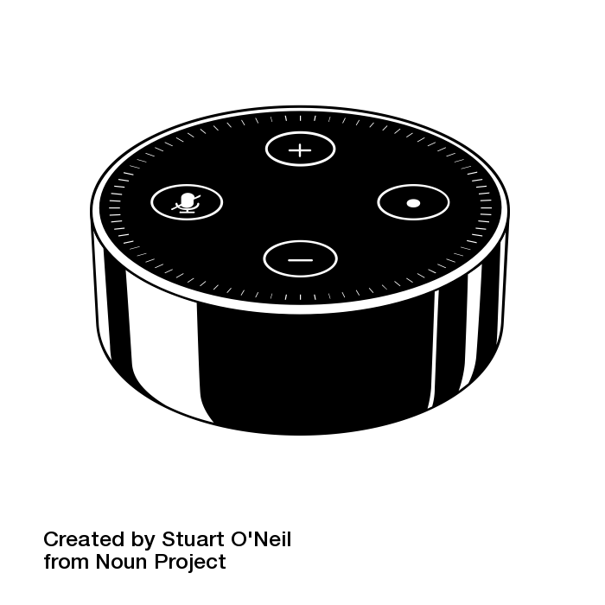
CONVERSATIONAL UI’S
(ALEXA, ETC)
Notes:
Amazon Echo by Sarah Stenseng from the Noun Project
alexa by Stuart O'Neil from the Noun Project

Slide 56
CI/CD INTEGRATION
OR CHAT OPS

Slide 57
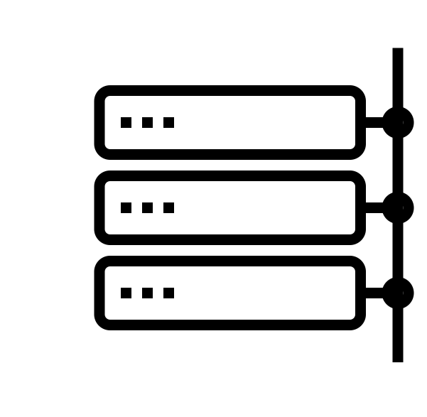
BACKEND SERVICES
Notes:
Local Net by Yaroslav Samoylov from the Noun Project
Logging
Post Handlers
Authentication
etc

Slide 58
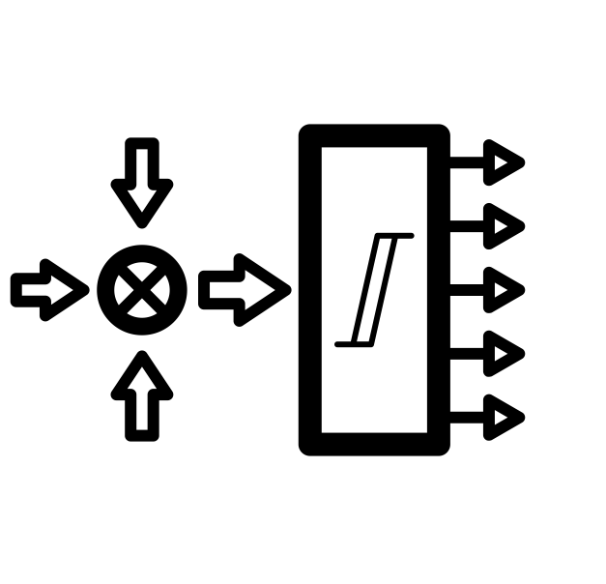
EVENT PROCESSING
Notes:
Complex Event Processing by H Alberto Gongora from the Noun Project
Event processing
Monitoring
Notifications
Alerting
Security Scanning
etc

Slide 59
WHERE DO WE START?

Slide 60




PROPRITARY FAAS EXTENSIONS
AWS Lambda
Google Cloud Functions

Slide 61

SPRING CLOUD FUNCTION

Slide 62
java.util.Supplier
java.util.Function
java.util.Consumer

Slide 63

STARTERS HANDLE THE REST

Slide 64
package io.spring.riffdemo;
import java.util.function.Function;
import org.springframework.boot.SpringApplication;
import org.springframework.boot.autoconfigure.SpringBootApplication;
import org.springframework.context.annotation.Bean;
@SpringBootApplication
public class RiffDemoApplication {
public static void main(String[] args) {
SpringApplication.run(RiffDemoApplication.class, args);
}
@Bean
public Function<String, String> reverse() {
return s -> new StringBuilder(s).reverse().toString();
}
}
LOOK AT CODE

Slide 65
WHERE DO WE RUN THIS CODE?

Slide 66


Slide 67
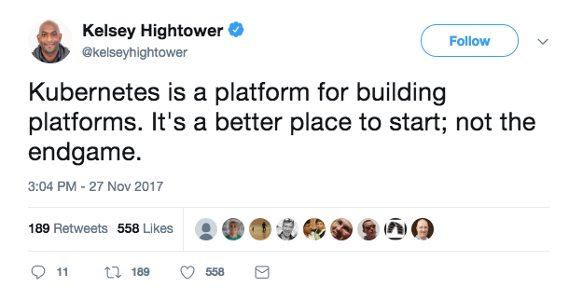
Notes:
https://twitter.com/kelseyhightower/status/935252923721793536?lang=en

Slide 68
Knative

Slide 69
1
DEVELOPER-FRIENDLY
SOFTWARE
Notes:
Automation including
Source to container workflows (no more creating your own docker image)
Routing traffic
Autoscaling
Binding to services
Universal subscription, deliver, and management of events
Think of all the Kubernetes YAML…much is covered here automagically

Slide 70
2
POLYGLOT
PLATFORM
Notes:
Docker is still the main container tech
Not quite as in your face as it is with raw Kubernetes

Slide 71
3
OPERATOR
FRIENDLY
Notes:
Scale to zero, request driven compute model
Works on all major cloud providers

Slide 72
Notes:
Started off as a serverless platform on Kubernetes
Has evolved to a extension of Knative in partnership with Google

Slide 73
TRIGGERED VIA EVENTS
Notes:
Rabbit or Kafka

Slide 74
CLI AND INVOKERS
➜ ~ riff service create square \
--image s1pt/node-fun-square

Slide 75
package io.spring.riffdemo;
import java.util.function.Function;
import org.springframework.boot.SpringApplication;
import org.springframework.boot.autoconfigure.SpringBootApplication;
import org.springframework.context.annotation.Bean;
@SpringBootApplication
public class RiffDemoApplication {
public static void main(String[] args) {
SpringApplication.run(RiffDemoApplication.class, args);
}
@Bean
public Function<String, String> reverse() {
return s -> new StringBuilder(s).reverse().toString();
}
}
RUN THE CODE

Slide 76
HAPPY DEVELOPERS

Slide 77

HAPPY BUSINESS

Slide 78
Notes:
Please ask questions when you have them

